Slide 1
Two Tank Interacting System
CH303: Process Control
Ankit Gond
Sayed Musaraf Ali
Dept. of Chemical Engineering, IIT Ropar.

Slide 2
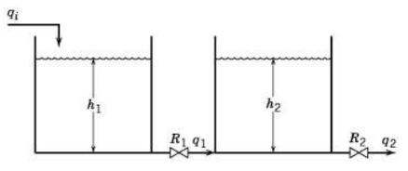
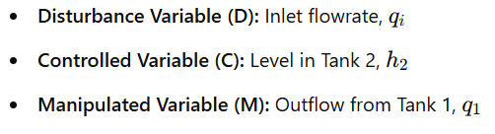
Process diagram
Objective:
To study dynamics, stability, and control of the liquid levels in the system.
State variables/ controlled variable: h2
Manipulated variables: q1
Disturbance variable: qi

Slide 3
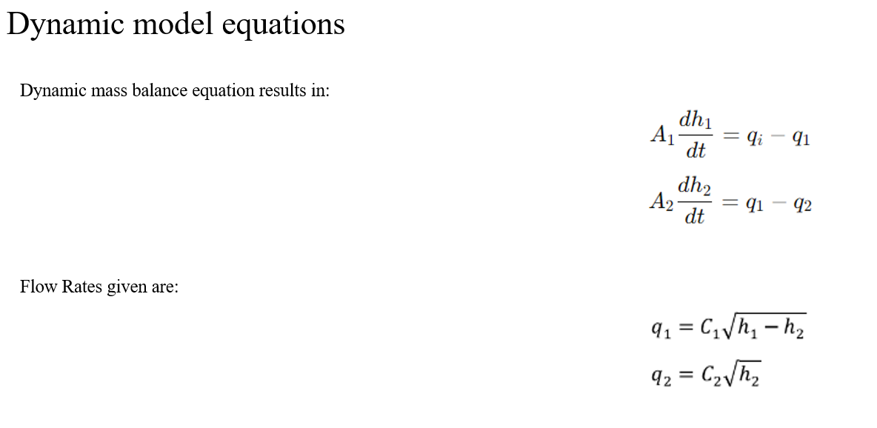
Process parameters
Parameter name | Value
Cross-sectional area of tank 1 (A1) | 3 ft2
Cross-sectional area of tank 2 (A2) | 5 ft2
Flow coefficient between the two tanks (C1) | 8 cfm/ft1/2
Flow coefficient for the outlet of tank 2 (C2) | 12 cfm/ft1/2

Slide 4
Empirical Modelling of Nonlinear Chemical Processes

Slide 5


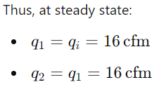

Steady-State Identification and Initial Conditions
Set the time derivatives
Now Steady State equations :
Now using these values in flow rate equations to find steady state h1 and h2

Slide 6
Development of empirical models: First Order/ FOPTD Models
Input Signal (u)
Output response(y)
Chemical Unit/Plant
Steps involved in developing the predictive model:
Data collection: Perturb the process through an input step signal, and record the output process data.
Model Selection: Through analysis of nature of output data, assume a suitable model form (first order transfer function or first order plus time delay model), between input and output variable (controlled variable), disturbance and controlled variable.
System Identification: Estimating the unknown parameters of the chosen model (i.e., process gain, time constant) through regression modelling approaches.
Cross Validation: Once the parameters are identified, validate the developed model with the collected data.

Slide 7
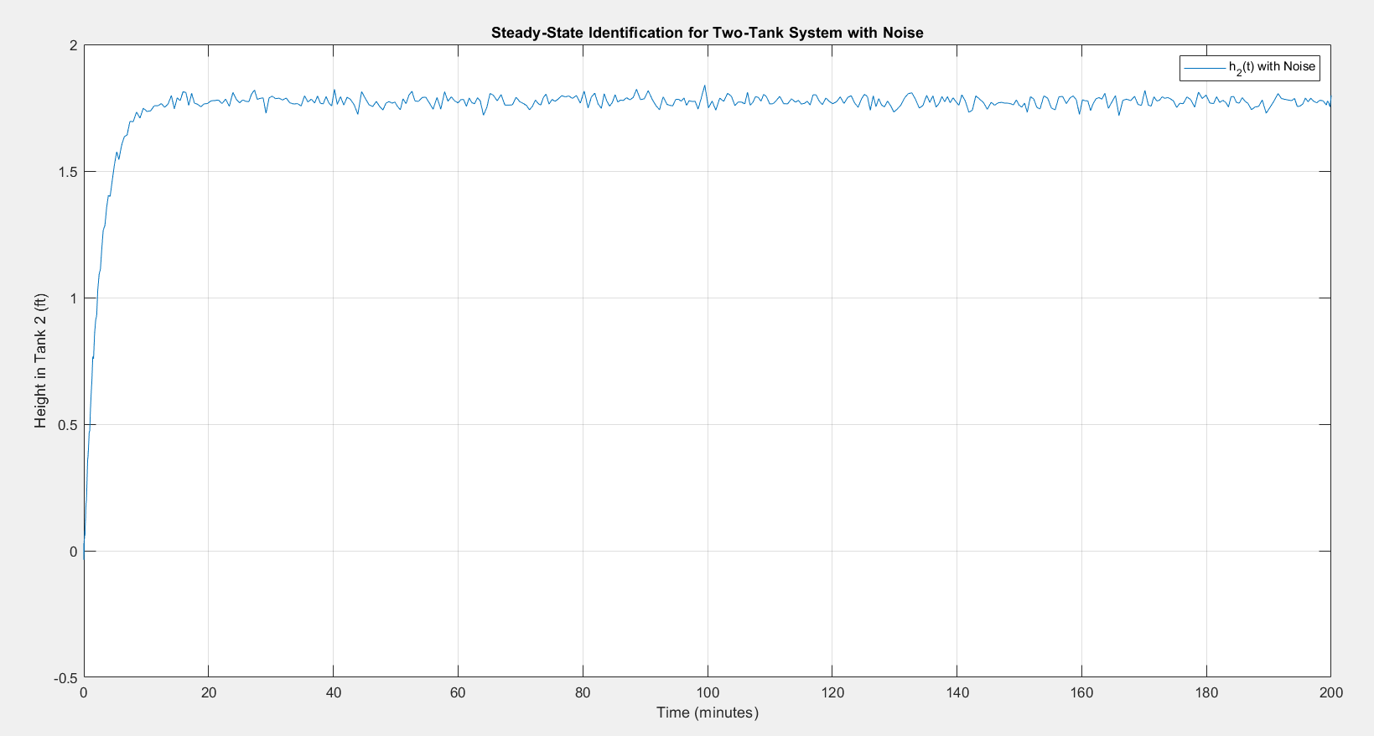

Slide 8
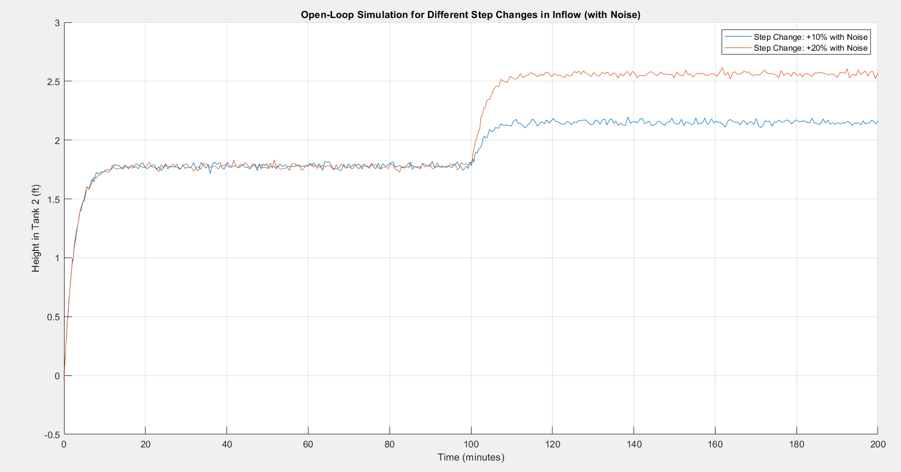

Slide 9
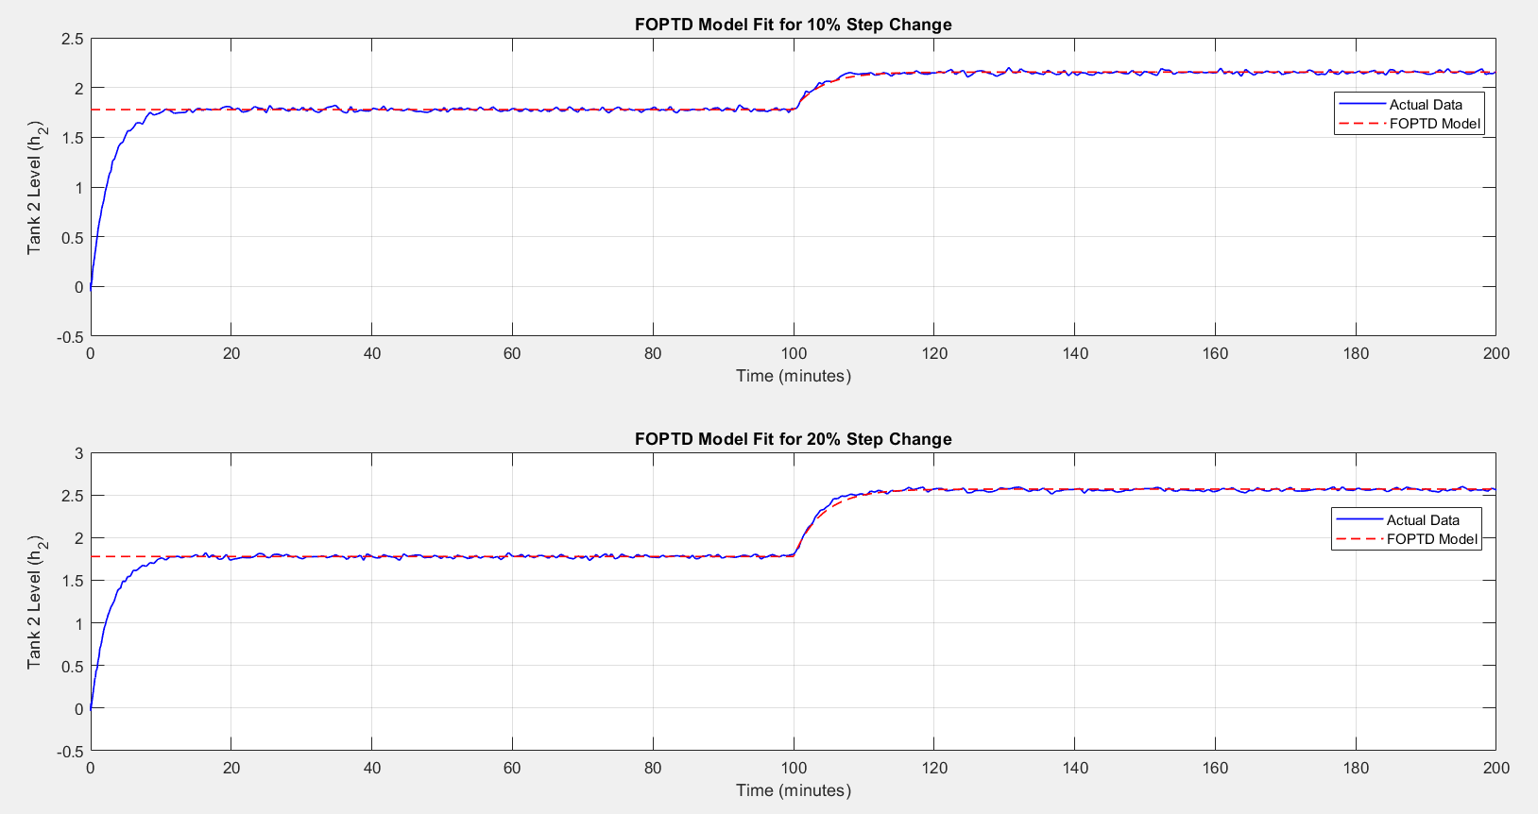

Slide 10
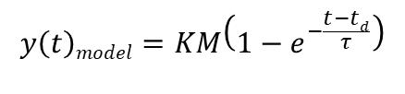


Method of identifying transfer function parameters
Regression method
Consider estimating parameters of FOPTD model i.e.,
M = Step change in input variable = 10% or 20% of Inlet Flow rate = 1.6 or 3.2
Unknown parameters here : $\left(K, τ,θ\right)$
Define error function, $ε(t)$ =
Objective function:
$\min_{θ}{\sum_{t=1}^{N}{{ε(t)}^{2}}}$
subject to: $y\left(t\right)model=y\left(t=0\right)+KM\left(1−e^{−\frac{t−td}{τ}}\right)$
$$y\left(t\right)model=KM\left(1−e^{−\frac{t−td}{τ}}\right)$$
$$y(t)plant−y\left(t\right)model$$

Slide 11
Parameters and Errors (Approx.)
Parameters | 10 % Input | 20 % Input | Mean
Kp (Process Gain) | 0.24 | 0.25 | 0.24
Tau | 4.00 | 4.12 | 4.06
Time Delay | 0 | 0 | 0
Mean Squared Error (MSE) is used as a metric to evaluate the performance of the model. (70% Training Datasets and 30% Validation Datasets)
Validation MSE for 10% step change | 0.0004
Validation MSE for 20% step change | 0.0004

Slide 12
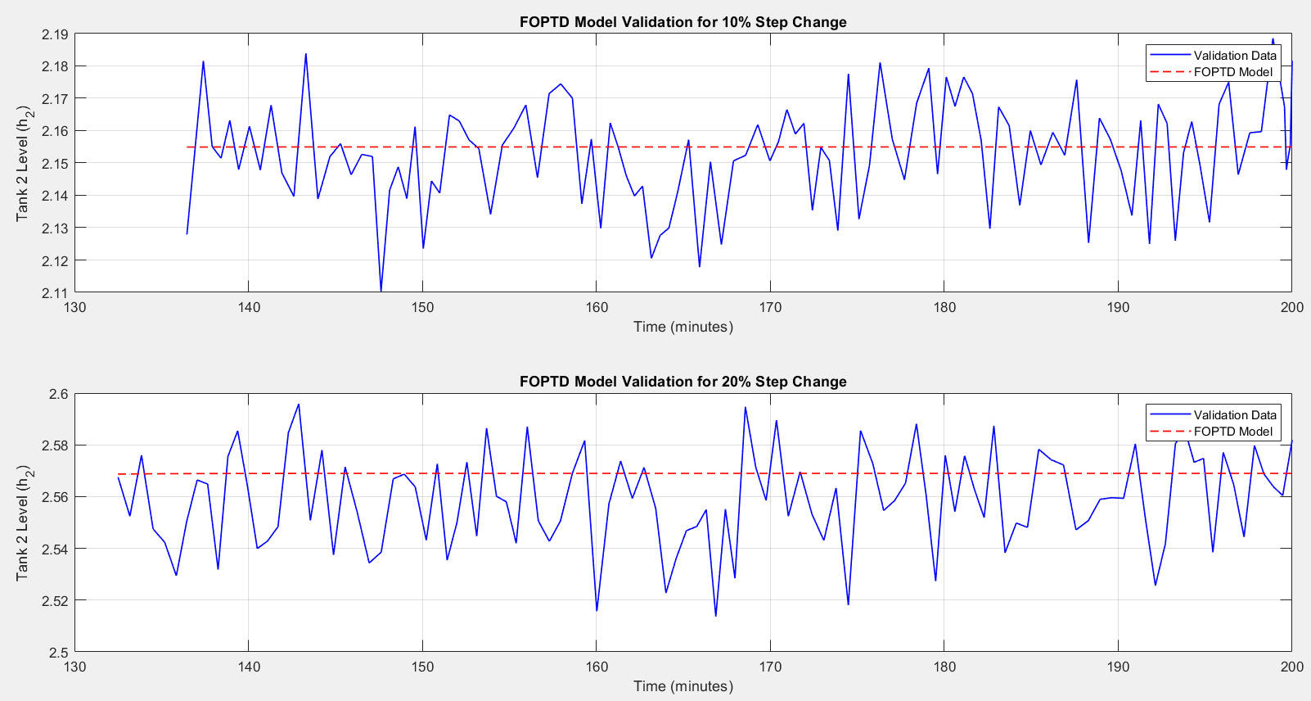

Slide 13
Stability Analysis & Feedback Control Design

Slide 14

Procedure for Closed Loop Stability Analysis
System Setup:
Use the parameters Kp, τ, and time delay obtained from the designed FOPTD model.
Implement the two-tank system as a closed-loop system with proportional (P) control.
Stability Analysis:
Define the closed-loop transfer function using the FOPTD model and the P controller gain Kc​.
Analyze the characteristic equation for stability using the Routh-Hurwitz criterion or root locus method.
Evaluate the system's poles to determine stability, focusing on whether all poles lie in the left half-plane (for continuous-time systems).
Characteristic equation;
Validation:
Simulate the closed-loop response for a range of Kc​ values to observe stability behavior and oscillations.
Identify the critical gain (Kc_critical) where the system transitions from stable to unstable.
$$Ts+K_{p}K_{c}+1=0$$

Slide 15
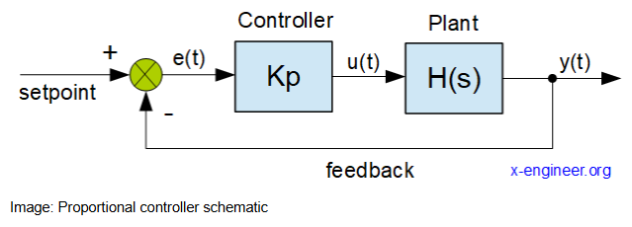

Feedback Control Design
P Controller Design:
The P controller [ $U=K_{c}\left(Y_{sp}−Y\right)]$ was implemented to adjust the inflow rate based on the error between the setpoint $Y_{sp}$ and the tank level $Y.$
The gain Kc​ was selected based on the stability analysis results to ensure a balance between fast response and stability.

Slide 16
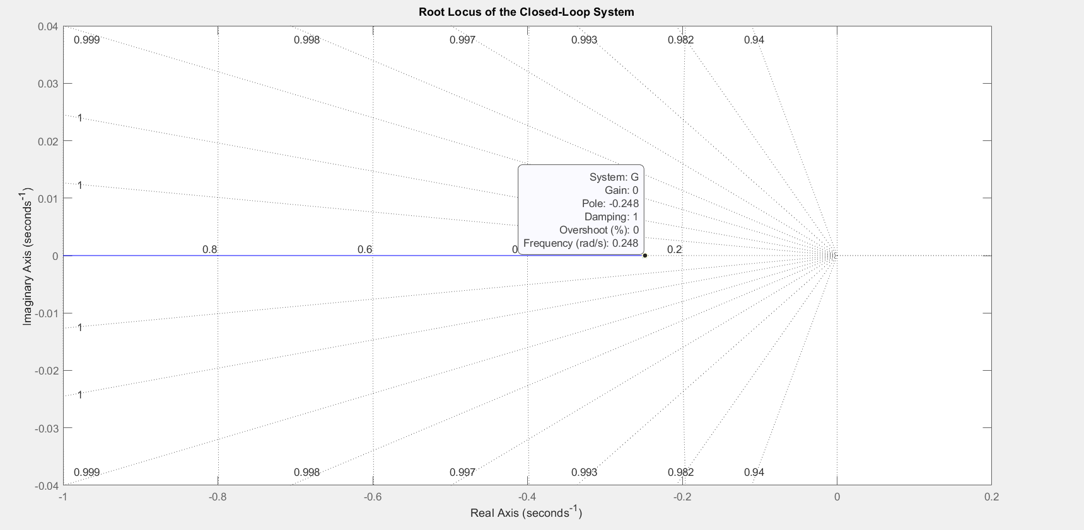

Slide 17
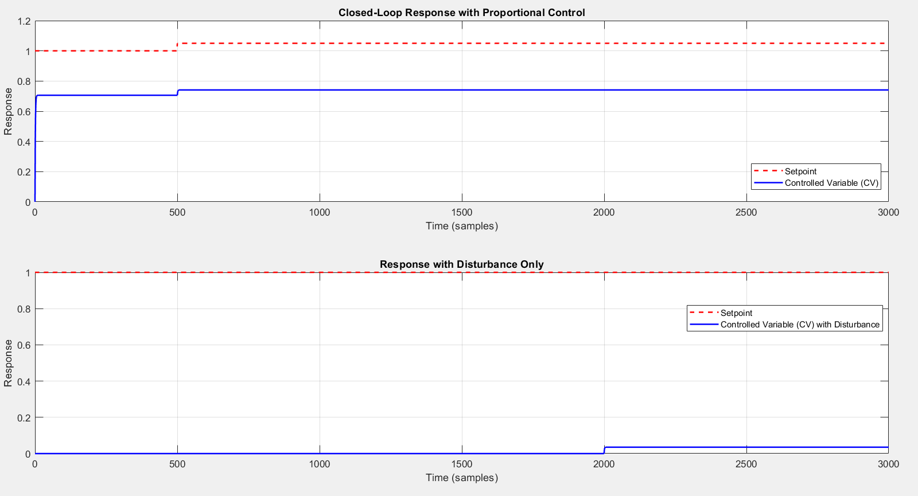

Slide 18
Conclusions
Conclusion of Project Task 1:
Modeled the two-tank system using FOPTD approximation, identifying key parameters Kp​, τ, and θ.
Achieved accurate system response for 10% and 20% step changes with low MSE, validating the model.
Analyzed steady-state conditions and added noise to simulate real-world behavior.
Conclusion of Project Task 2:
Stability analysis showed a stable system with a single pole at -0.248.
Designed a P controller using parameters from Project Task 1 for effective setpoint tracking and disturbance rejection.
Ensured system stability with minimal overshoot and steady-state error through proper tuning.

Slide 19
Key Learnings from the Course and Project-Based Learning:
Dynamic System Modeling: Gained hands-on experience in modeling real-world processes using FOPTD approximation.
Stability and Control: Learned to analyze system stability using tools like root locus and designed effective feedback control.
Optimization and Parameter Estimation: Developed skills in tuning parameters for accurate system behavior and performance.
Noise Handling: Understood the impact of noise in real systems and methods to mitigate its effects in control applications.
Practical Application: Bridged theory and practice by applying control principles to a simulated two-tank system, enhancing problem-solving and critical thinking.

Slide 20
THANK YOU

